Slide 1

INTRODUCTION TO MACHINE LEARNING
- UNIT 1

Slide 2
REVIEW OF LINEAR ALGEBRA FOR MACHINE LEARNING
Basics :
Scalars: Single values, denoted as lowercase letters (e.g., aaa).
Vectors: Ordered lists of numbers denoted as bold lowercase (e.g., v\mathbf{v}v).
Matrices: 2D arrays of numbers denoted as bold uppercase (e.g., A\mathbf{A}A).
Tensors: Generalizations of vectors & matrices to higher dimensions.
Eigen vector: The direction that doesn’t change under transformation.
Eigen value: The factor by which the eigen vector is scaled under transformation.
2. Key Operations :
Addition/Subtraction: Element-wise for same-sized matrices or vectors.
Scalar Multiplication: Each element is multiplied by a scalar.
Dot Product: Multiplication of two vectors to yield a scalar (measures similarity).
Matrix Multiplication: Combines two matrices; central for transformations (applying weights).

Slide 3
REVIEW OF LINEAR ALGEBRA FOR MACHINE LEARNING
Linear Algebra for Machine learning :
Linear Algebra is an essential field of mathematics, which defines the study of vectors, matrices, planes, mapping, and lines required for linear transformation.
Linear algebra plays a vital role and key foundation in machine learning, and it enables ML algorithms to run on a huge number of datasets.
Linear algebra is used almost in each concept of Machine learning, specifically, it can perform the following task:
o Optimization of data.
o Applicable in loss functions, regularization, covariance matrices, Singular Value Decomposition (SVD), Matrix Operations, and support vector machine classification.
o Implementation of Linear Regression in Machine Learning.
o Linear algebra is also used in neural networks and the data science field.

Slide 4
REVIEW OF LINEAR ALGEBRA FOR MACHINE LEARNING
Minimum Linear Algebra for Machine Learning :
Notation:
Notation in linear algebra enables you to read algorithm descriptions in papers, books, and websites to understand the algorithm's working. Even if you use for-loops rather than matrix operations, you will be able to piece things together.
Operations:
Working with an advanced level of abstractions in vectors and matrices can make concepts clearer, and it can also help in the description, coding, and even thinking capability. In linear algebra, it is required to learn the basic operations such as addition, multiplication, inversion, transposing of matrices, vectors, etc.
Matrix Factorization:
One of the most recommended areas of linear algebra is matrix factorization, specifically matrix deposition methods such as Singular Value Decomposition and QR Decomposition

Slide 5
REVIEW OF LINEAR ALGEBRA FOR MACHINE LEARNING
Benefits of learning Linear Algebra before Machine learning:
Linear Algebra helps solve and compute large and complex data set through a specific terminology named Matrix Decomposition Techniques. There are two most popular matrix decomposition techniques, which are as follows: • Q-R • L-U
Creating better Machine Learning algorithms:
Supervised learning algorithms can
be created using Linear Algebra as:
Logistic Regression
Linear Regression
Decision Trees
Support Vector Machines (SVM)
Unsupervised learning algorithms can
also be created with linear algebra as :
Single Value Decomposition (SVD)
Clustering
Components Analysis

Slide 6
REVIEW OF LINEAR ALGEBRA FOR MACHINE LEARNING
Minimum Linear Algebra for Machine Learning:
Notation:
Enables understanding of algorithms by interpreting their notation, even if matrix operations aren’t directly used.
Operations:
Familiarity with basic matrix and vector operations (addition, multiplication, inversion, transposition) aids in conceptual clarity and coding.
Matrix Factorization:
Essential techniques like SVD and QR decompositions are valuable for tasks like dimensionality reduction in machine learning.
This foundational knowledge in linear algebra is critical for effectively working with machine learning algorithms.

Slide 7
REVIEW OF LINEAR ALGEBRA FOR MACHINE LEARNING
Examples of Linear Algebra in Machine Learning :
Datasets and Data Files
Images and Photographs
One Hot Encoding
Linear Regression
Regularization
Principal Component Analysis
Singular-Value Decomposition
Latent Semantic Analysis
Recommender System
Deep Learning

Slide 8
REVIEW OF LINEAR ALGEBRA FOR MACHINE LEARNING
Benefits of learning Linear Algebra before Machine learning :
• Better Graphic experience
• Improved Statistics
• Creating better Machine Learning algorithms
• Estimating the forecast of Machine Learning
• Easy to Learn
Supervised learning algorithms can be created using Linear Algebra :
• Logistic Regression
• Linear Regression
• Decision Trees
• Support Vector Machines (SVM)
Unsupervised learning algorithms can be created using Linear Algebra :
• Single Value Decomposition (SVD)
• Clustering
• Components Analysis

Slide 9
INTRODUCTION AND MOTIVATION FOR MACHINE LEARNING
Arthur Samuel, an early American leader in the field of computer gaming and artificial intelligence, coined the term “Machine Learning” in 1959 while at IBM.
Machine learning is a subset of artificial intelligence that involves using algorithms and statistical models to enable computers to perform tasks without being explicitly programmed. ML allows systems to learn from data and improve their performance over time based on experience.
Types of Machine Learning:
Supervised learning – Also called predictive learning. A machine predicts the class of unknown objects based on prior class-related information of similar objects.
Unsupervised learning – Also called descriptive learning. A machine finds patterns in unknown objects by grouping similar objects together.
c. Semi-supervised Learning: A mix of labeled and unlabeled data is used, when labeled data is scarce.
d. Reinforcement learning – A machine learns to act on its own to achieve the given goals.

Slide 10
INTRODUCTION AND MOTIVATION FOR MACHINE LEARNING
The basic machine learning process can be divided into three parts:
Data Input: Past data or information is utilized as a basis for future decision-making
Abstraction: The input data is represented in a broader way through the underlying algorithm
Generalization: The abstracted representation is made to form a framework for making decisions
Fig. A schematic representation of the machine learning process.

Slide 11
SIGNIFICANT MILESTONES IN THE JOURNEY OF MACHINE LEARNING
1950: Alan Turing proposes the concept of a "learning machine."
1952: Arthur Samuel develops the first machine learning program that can play Checkers.
1957: Frank Rosenblatt creates the first neural network model, simulating the human brain.
1967: Nearest neighbor algorithm is developed, marking the beginning of basic pattern recognition.
1979: Stanford students develop the first self-driving cart capable of navigating obstacles.
1982: Recurrent Neural Networks (RNN) are developed.
1989: Conceptualization of reinforcement learning and start of machine learning commercialization.
1995: Introduction of Random Forest and Support Vector Machine (SVM) algorithms.
1997: IBM's Deep Blue beats world chess champion Gary Kasparov.
2006: Netflix launches the first machine learning competition, Hinton introduces Deep Learning.
2010: Kaggle, a platform for machine learning competitions, is launched.
2011: IBM’s Watson wins against two human champions in Jeopardy.
2016: Google’s AlphaGo beats an unhandicapped professional Go player.

Slide 12
SIGNIFICANT MILESTONES IN THE JOURNEY OF MACHINE LEARNING
Definition of learning:
A computer program is said to learn from experience E with tasks T and performance measure P, if its performance at tasks T, as measured by P, improves with experience E.
Examples :
Handwriting recognition learning problem :
Task T: Recognizing and classifying handwritten words within images
Performance P: Percent of words correctly classified
Training experience E: A dataset of handwritten words with given classifications
A robot driving learning problem :
Task T: Driving on highways using vision sensors
Performance P: Average distance traveled before an error
Training experience E: A sequence of images and steering commands recorded while observing a human driver

Slide 13
SUPERVISED LEARNING
Supervised learning:
• Supervised learning is the machine learning task of learning a function that maps an input to an output based on example input output pairs.
• The given data is labeled.
• Both classification and regression problems are supervised learning problems.
• For example, the inputs could be camera images, each one accompanied by an output saying “bus” or “pedestrian,” etc.
• An output like this is called a label.
• The agent learns a function that, when given a new image, predicts the appropriate label.

Slide 14
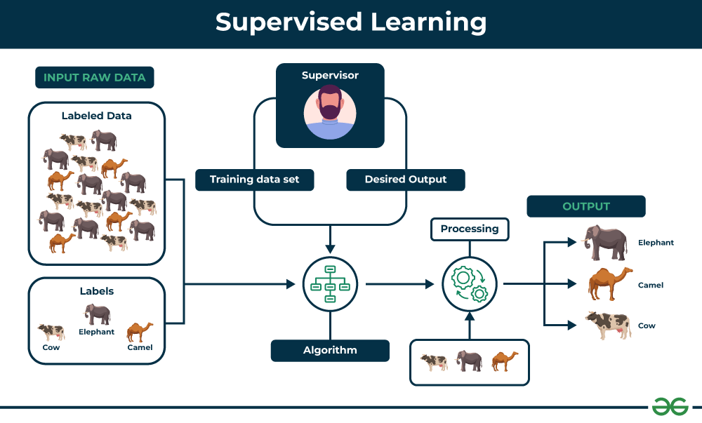
SUPERVISED LEARNING

Slide 15
UNSUPERVISED LEARNING
Unsupervised learning:
Unsupervised learning algorithm is trained on an unlabeled dataset, where the data points do not have corresponding labels or output values. The algorithm learns to identify patterns and structures in the data without explicit guidance.
Unsupervised learning is a type of machine learning algorithm used to draw inferences from datasets consisting of input data without labeled responses.
In unsupervised learning algorithms, classification or categorization is not included in the observations.
The most common unsupervised learning task is clustering: detecting potentially useful clusters of input examples.
For example, when shown millions of images taken from the Internet, a computer vision system can identify a large cluster of similar images which an English speaker would call “cats.”

Slide 16
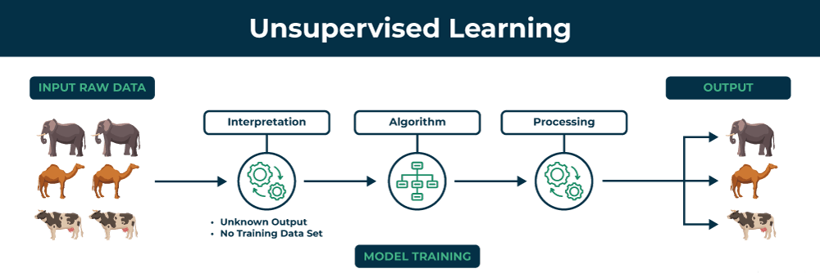
UNSUPERVISED LEARNING

Slide 17
SIGNIFICANT MILESTONES IN THE JOURNEY OF MACHINE LEARNING

Slide 18
SEMI-SUPERVISED LEARNING
Semi-Supervised learning is a type of Machine Learning algorithm that represents the intermediate ground between Supervised and Unsupervised learning algorithms.
It uses the combination of labeled and unlabeled datasets during the training period, where an incomplete training signal is given: a training set with some of the target outputs missing.
Semi-supervised learning is a machine learning approach or technique that works in combination of supervised and unsupervised learning. In semi-supervised learning, the machine learning algorithms are trained on a small amount of labeled data and a large amount of unlabeled data.
The goal of semi-supervised learning is to develop an algorithm to divide the entire data into different clusters and the data points closer to each other most likely share the same output label, and then to classify the cluster into a predefined category.

Slide 19
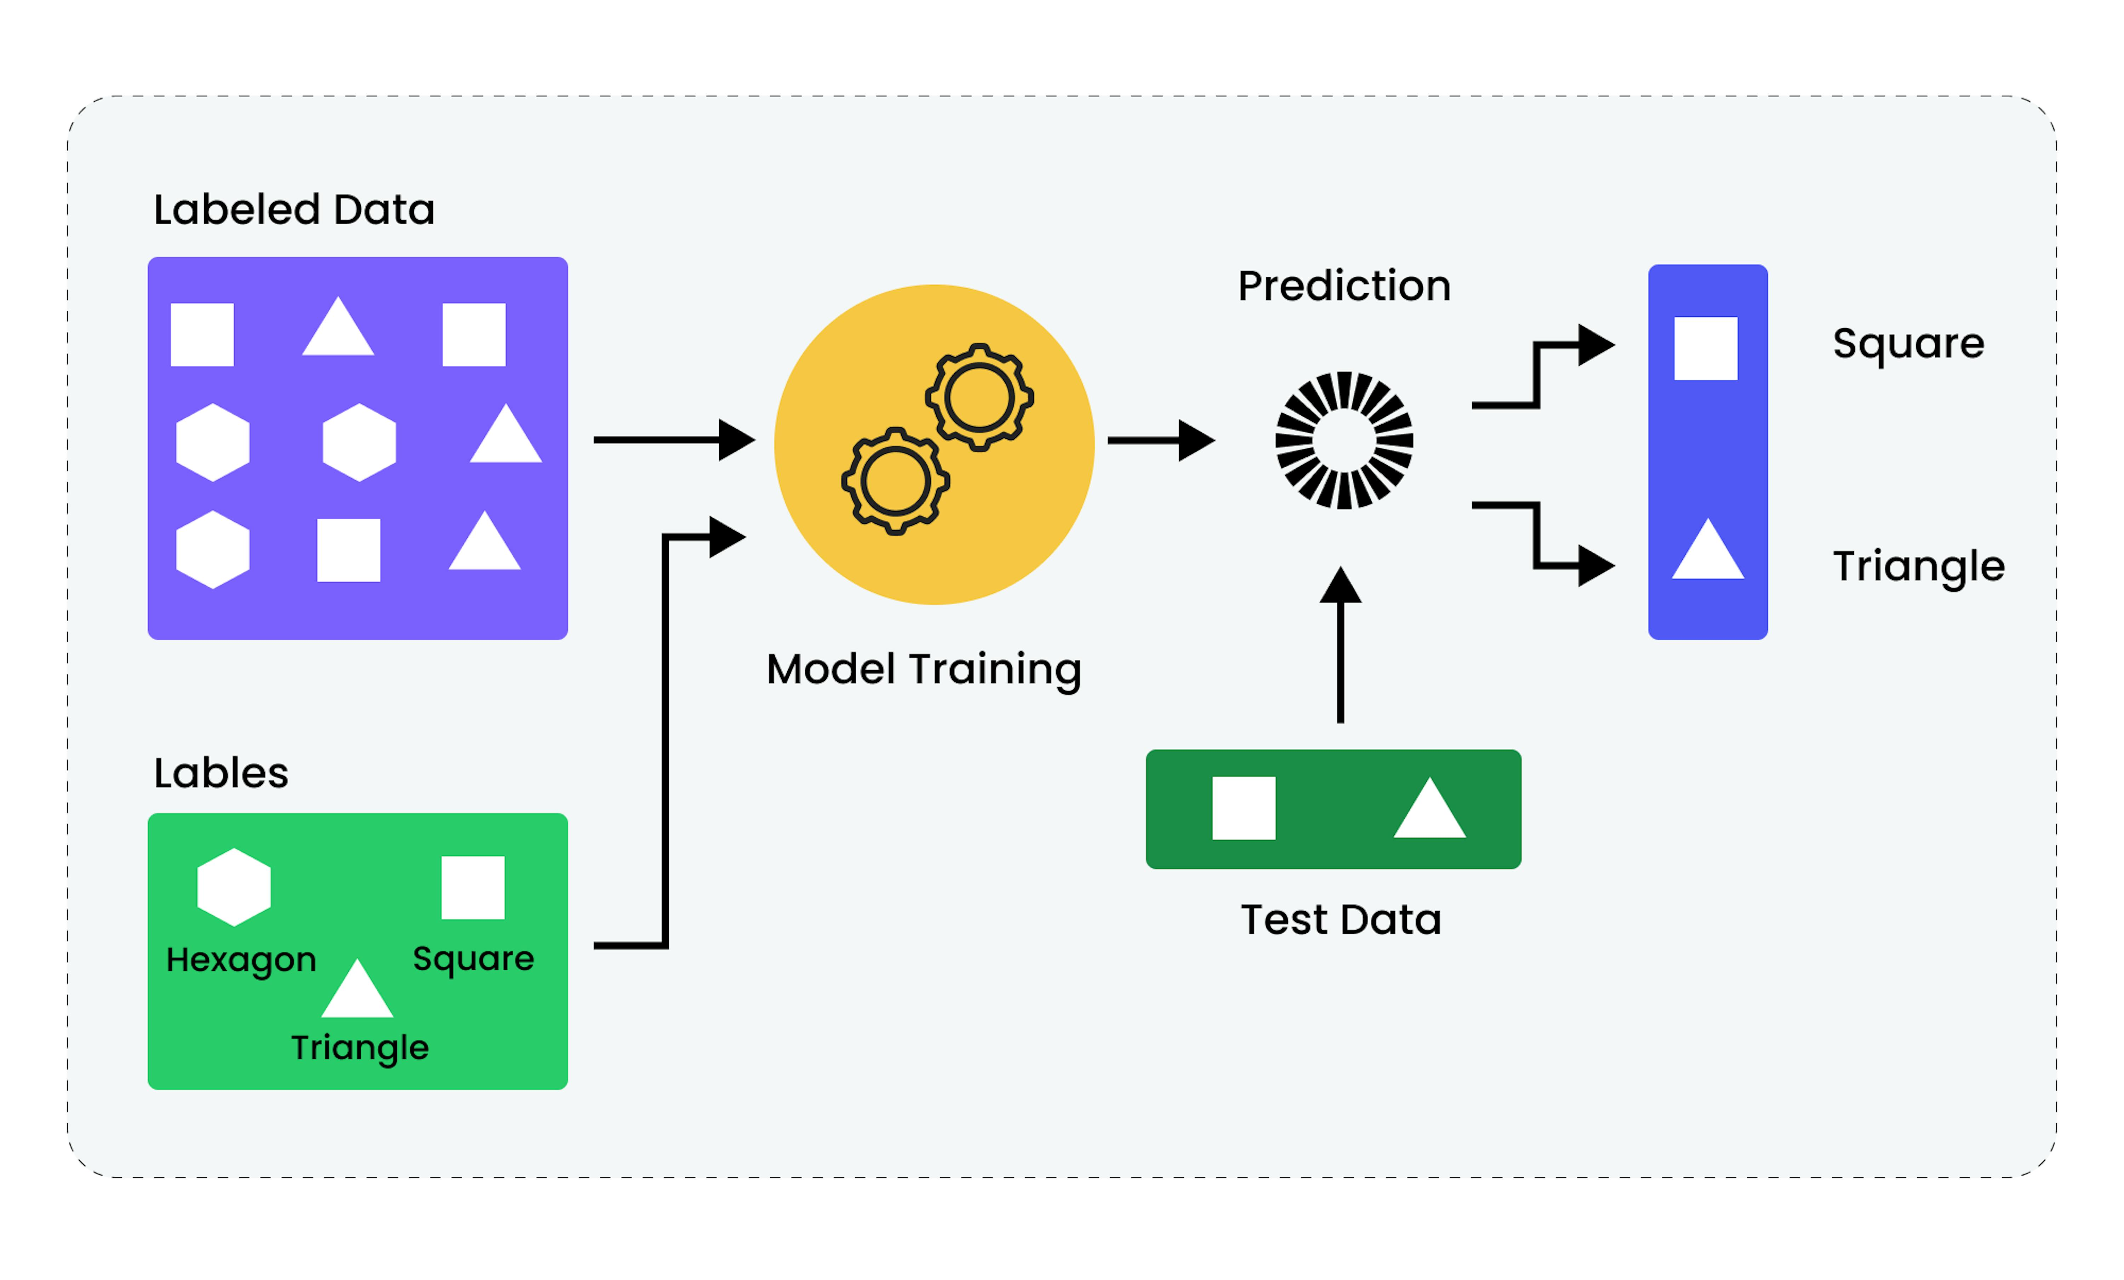
SEMI-SUPERVISED LEARNING

Slide 20
SEMI-SUPERVISED LEARNING
Challenges of Semi-supervised Learning :
Quality of data − The efficiency of semi-supervised learning depends on the quality of unlabeled data. If the unlabeled data is noisy or irrelevant, there are chances that it might to lead to incorrect predictions and poor performance.
Variation in the data − Semi-supervised learning models are more prone to distribution shifts between the labeled and unlabeled data. For examples, a model is trained on labeled dataset that consists clear high quality images where as the if the unlabeled data contains images from captured from surveillance cameras, it would be difficult to generalize from the labeled to the unlabeled images, impacting the outcomes.
Applications of semi-supervised learning are :
Speech Recognition
Web Content Classification
Text Document Classification

Slide 21
SEMI-SUPERVISED LEARNING
Approaches for implementing semi-supervised learning methods :
The first and simple approach is to build the supervised model based on a small labeled and annotated data and then build the unsupervised model by applying the same to the large amounts of unlabeled data to get more labeled samples. Now, train the model on them and repeat the process.
The second approach needs some extra efforts. In this approach, we can first use the unsupervised methods to cluster similar data samples, annotate these groups and then use a combination of this information to train the model.
Assumptions held for the working of semi-supervised learning like :
Smoothness Assumption
Cluster Assumption
Low Density Separation
Manifold Assumptions

Slide 22
SIGNIFICANT MILESTONES IN THE JOURNEY OF MACHINE LEARNING
Reinforcement learning:
In reinforcement learning the agent learns from a series of reinforcements: rewards and punishments.
Reinforcement learning is the problem of getting an agent to act in the world so as to maximize its rewards.
A learner is not told what actions to take as in most forms of machine learning but instead must discover which actions yield the most reward by trying them.
For example - Consider teaching a dog a new trick: we cannot tell him what to do, what not to do, but we can reward/punish it if it does the right/wrong thing.

Slide 23
REINFORCEMENT LEARNING
In reinforcement learning the agent learns from a series of reinforcements: rewards and punishments.
Reinforcement learning is the problem of getting an agent to act in the world so as to maximize its rewards.
A learner is not told what actions to take as in most forms of machine learning but instead must discover which actions yield the most reward by trying them.
For example — Consider teaching a dog a new trick: we cannot tell him what to do, what not to do, but we can reward/punish it if it does the right/wrong thing.
Elements of Reinforcement Learning :
Policy: Defines the agent’s behavior at a given time.
Reward Function: Defines the goal of the RL problem by providing feedback.
Value Function: Estimates long-term rewards from a state.
Model of the Environment: Helps in predicting future states and rewards for planning.

Slide 24
REINFORCEMENT LEARNING
Types of Reinforcement:
Positive Reinforcement : Defined as when an event, occurs due to a particular behavior, increases the strength and the frequency of the behavior. In other words, it has a positive effect on behavior. Advantages of reinforcement learning are:
Maximizes Performance
Sustain Change for a long period of time
Too much Reinforcement can lead to an overload of states which can diminish the results
Negative Reinforcement : Defined as strengthening of behavior as a negative condition is stopped or avoided. Advantages of reinforcement learning:
Increases Behavior
Provide defiance to a minimum standard of performance
It Only provides enough to meet up the minimum behavior

Slide 25
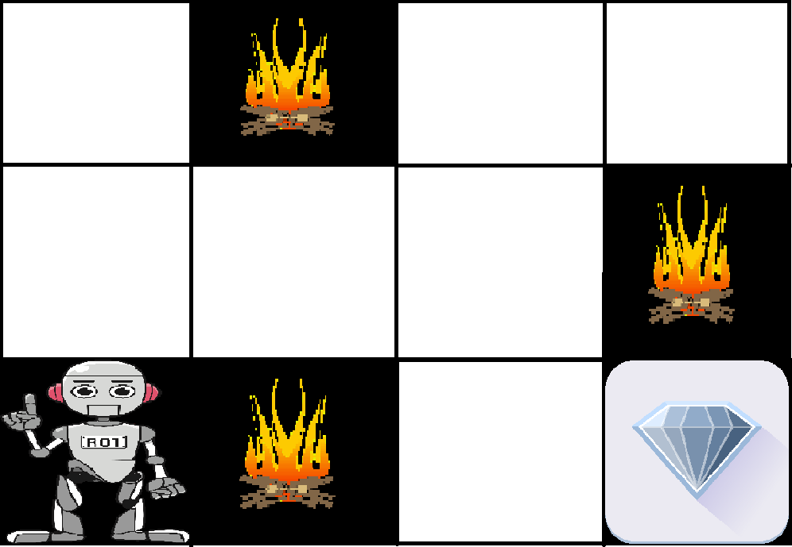
REINFORCEMENT LEARNING
Example: Navigating a Maze
The problem is as follows: We have an agent and a reward, with many hurdles in between. The agent is supposed to find the best possible path to reach the reward. The following problem explains the problem more easily.
The above image shows the robot, diamond, and fire. The goal of the robot is to get the reward that is the diamond and avoid the hurdles that are fired. The robot learns by trying all the possible paths and then choosing the path which gives him the reward with the least hurdles. Each right step will give the robot a reward and each wrong step will subtract the reward of the robot. The total reward will be calculated when it reaches the final reward that is the diamond.

Slide 26
EXAMPLES OF MACHINE LEARNING
Image Recognition and Computer Vision
Facial Recognition: Used in social media, surveillance, and smartphone security, facial recognition systems can identify or verify people based on their facial features
Object Detection: Self-driving cars rely on computer vision to detect and classify objects like other cars, pedestrians, and traffic signals, ensuring safe navigation.
Medical Imaging: AI models help radiologists detect abnormalities (like tumors) in X-rays, MRIs, and CT scans, aiding early diagnosis and treatment planning.
Augmented Reality (AR): Image recognition algorithms track real-world objects, which AR applications then overlay with virtual content for gaming, shopping, or remote assistance.

Slide 27
EXAMPLES OF MACHINE LEARNING
2. Natural Language Processing (NLP)
Language Translation: Apps like Google Translate use NLP models to translate text or speech in real-time, supporting multiple languages.
Sentiment Analysis: Businesses use NLP to analyze customer sentiment in reviews or social media, helping them understand consumer opinions.
Chatbots and Virtual Assistants: Siri, Alexa, and other voice-activated assistants use NLP to understand spoken language, answer questions, and perform tasks.
Content Generation and Summarization: Tools like GPT can generate human-like text, summarize articles, or assist with creative writing, enhancing productivity.

Slide 28
VC DIMENSION
VC Dimension :
(Vapnik-Chervonenkis Dimension): The VC dimension is quantify how powerful is the model , a measure of a model’s capacity, or its ability to classify a variety of data patterns.
It’s defined as the maximum number of points a model can shatter, meaning the model can perfectly classify all possible labelings of those points.
Higher VC dimensions imply more complex models, potentially leading to overfitting, while lower VC dimensions suggest simpler models that may underfit.
VC dimension number after model = maximum number points that can be separated that can be separated by a model for all possible configuration

Slide 29

VC DIMENSION SHATTERING OF A SET
Let D be a dataset containing N examples for a binary classification problem with class labels 0 and 1. Let H be a hypothesis space for the problem. Each hypothesis h in H partitions D into two disjoint subsets as follows:
{x ∈ D ∣ h(x) = 0} and {x ∈ D ∣ h(x) = 1}.
Such a partition of S is called a “dichotomy” in D. It can be shown that there are 2 N possible dichotomies in D. To each dichotomy of D there is a unique assignment of the labels “1” and “0” to the elements of D. If S is any subset of D then, S defines a unique hypothesis h as:

Slide 30
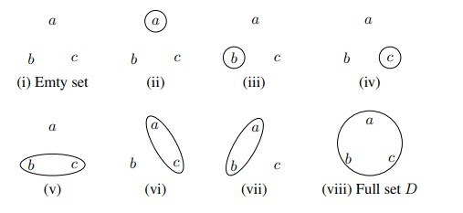
VC DIMENSION SHATTERING OF A SET
To specify a hypothesis h, we need only specify the set {x ∈ D | h(x) = 1}.
Fig. shows all possible dichotomies of D if D has three elements. In the figure, we have shown only one of the two sets in a dichotomy, namely the set
{x ∈ D | h(x) = 1}. The circles and ellipses represent such sets.
Different forms of the set{xεS:h(x)=1} for D={a,b,c}
Definition A set of examples D is said to be shattered by a hypothesis space H if and only if for every dichotomy of D there exists some hypothesis in H consistent with the dichotomy of D.
The following example illustrates the concept of Vapnik-Chervonenkis dimension.

Slide 31
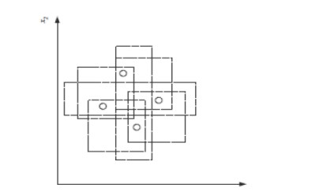
VC DIMENSION SHATTERING OF A SET
Then VC(H), when H is the hypothesis class of axis-aligned rectangles in two dimensions, is four. In calculating the VC dimension, it is enough that we find four points that can be shattered; it is not necessary that we be able to shatter any four points in two dimensions.
Fig. An axis-aligned rectangle can shattered four points. Only rectangle
covering two points are shown
VC dimension may seem pessimistic. It tells us that using a rectangle as our hypothesis class, we can learn only datasets containing four points and not more.

Slide 32
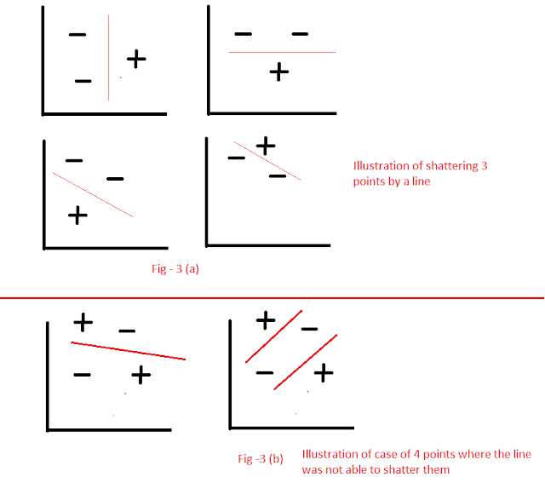
VC DIMENSION SHATTERING OF A SET

Slide 33
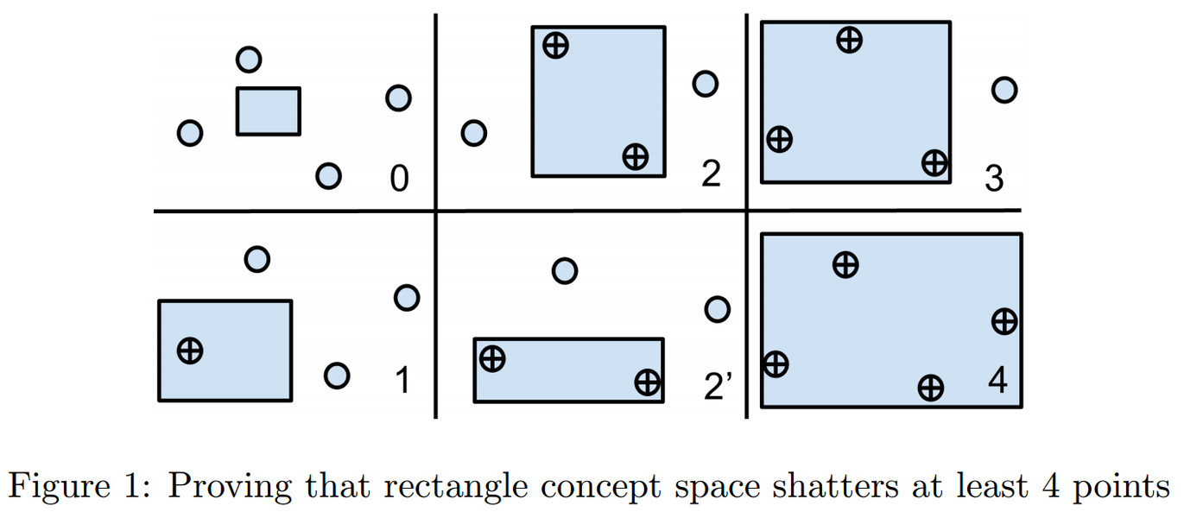
VC DIMENSION SHATTERING OF A SET

Slide 34
PROBABLY APPROXIMATELY CORRECT (PAC) LEARNING
Probably Approximately Correct (PAC) Learning is a framework in machine learning that quantifies a model's ability to learn from data. In PAC learning, a model is considered successful if, with high probability (the "Probably" part), it can learn a hypothesis that is approximately correct—that is, close enough to the true function or distribution generating the data.
Key points:
Probably: The model will produce an accurate hypothesis with a high probability (e.g., 95%).
Approximately Correct: The hypothesis may not be perfect, but its error is within an acceptable margin (ε).
Efficiency: PAC learning also considers the computational efficiency of finding this hypothesis within a reasonable amount of data and time.

Slide 35
PROBABLY APPROXIMATELY CORRECT (PAC) LEARNING
• PAC (Probably Approximately Correct) learning is a theoretical framework in machine learning that deals with the learning of hypotheses from a given set of data.
• It provides guarantees on the generalization performance of a learning algorithm by bounding the error between the learned hypothesis and the true hypothesis.
• The goal is that, with high probability (the "probably" part), the selected function will have low generalization error (the "approximately correct" part).
• In probably approximately correct (PAC) learning, given a class, C, and examples drawn from some unknown but fixed probability distribution, p(x), we want to find the number of examples, N, such that with probability at least 1 − δ, the hypothesis h has error at most ε, for arbitrary δ ≤ 1/2 and ε> 0
P{CΔh ≤ ε} ≥ 1 – δ
where CΔh is the region of difference between C and h.

Slide 36
PROBABLY APPROXIMATELY CORRECT (PAC) LEARNING
• In this case, because S is the tightest possible rectangle, the error region between C and h = S is the sum of four rectangular strips (see figure 2.7).
• We would like to make sure that the probability of a positive example falling in here (and causing an error) is at most ε.
• For any of these strips, if we can guarantee that the probability is upper bounded by ε /4, the error is at most 4(ε /4) = ε.
• Note that we count the overlaps in the corners twice, and the total actual error in this case is less than 4(ε /4).
• The probability that a randomly drawn example misses this strip is 1 − ε /4.
• The probability that all N independent draws miss the strip is (1− ε /4)N , and the probability that all N independent draws miss any of the four strips is at most 4(1 − ε /4)N , which we would like to be at most δ. We have the inequality.
(1 − x) ≤ exp[−x] rearranging terms, we have N ≥ (4/ ε log(4/δ

Slide 37
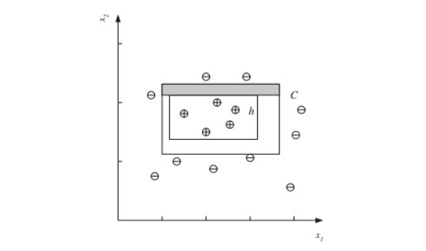
PROBABLY APPROXIMATELY CORRECT (PAC) LEARNING
So if we choose N and δ such that we have 4 exp[−ε N/4] ≤ δ
we can also write 4(1 − ε /4)N ≤ δ. Dividing both sides by 4, taking (natural) log and
Figure 1.4 The difference between h and C is the sum of four rectangle strips, one of which is shaded.
Therefore, provided that we take at least (4/ ε) log(4/δ) independent examples from C and use the tightest rectangle as our hypothesis h, with confidence probability at least 1 − δ, a given point will be misclassified with error probability at most ε. We can have arbitrary large confidence by decreasing δ and arbitrary small error by decreasing ε, and we see in equation 2.7 that the number of examples is a slowly growing function of 1/ ε and 1/δ, linear and logarithmic, respectively.

Slide 38
HYPOTHESIS SPACE
The hypothesis space in machine learning is the set of all possible models or functions that a learning algorithm can choose from to fit a given dataset. It includes every potential hypothesis (or function) that could map inputs to outputs based on the training data.
Why It’s Essential
Defines Learning Scope: The hypothesis space determines the complexity and flexibility of the models, influencing what patterns or relationships the model can learn from the data.
Affects Generalization: A too-large hypothesis space can lead to overfitting, where the model learns noise instead of patterns. A too-small hypothesis space may underfit, missing important data relationships.
Guides Model Selection: Choosing an appropriate hypothesis space helps balance model accuracy with computational efficiency and generalization ability on new data.

Slide 39
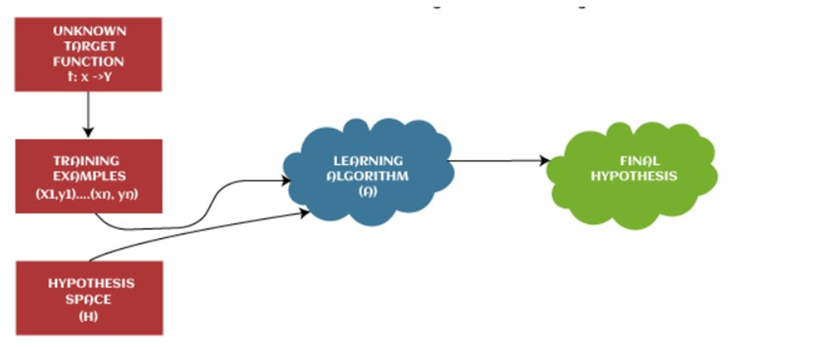
HYPOTHESIS SPACE
Hypothesis spaces in Machine Learning

Slide 40
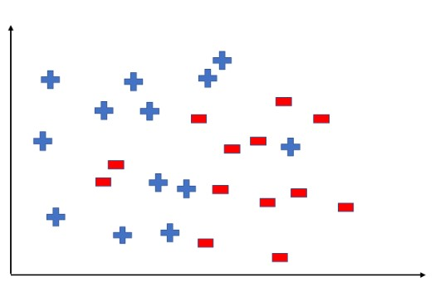
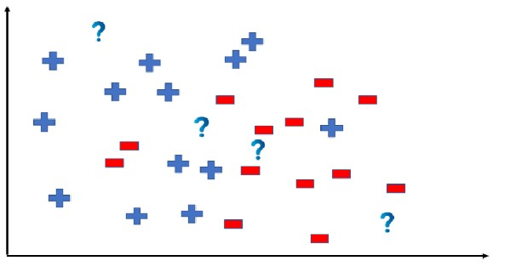
HYPOTHESIS SPACE
A hypothesis is a function that best describes the target in supervised machine learning.
The Hypothesis can be calculated as: y=mx + b ,
where y = range , m = slope of the lines, x = domain , b = intercept
Fig. Distribution of data to for hypothesis space
Fig. test data to determine the output

Slide 41
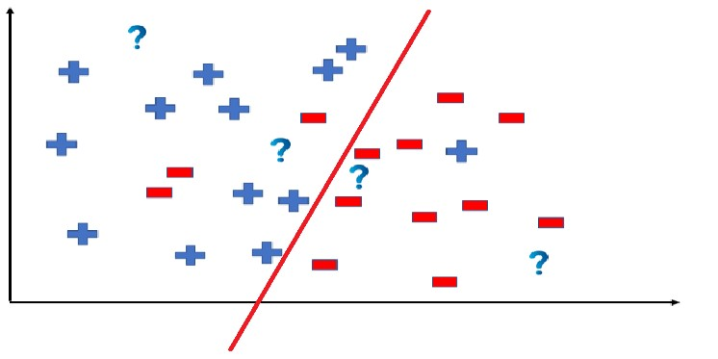
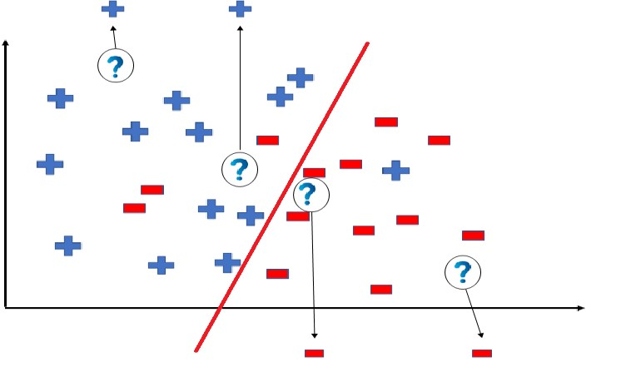
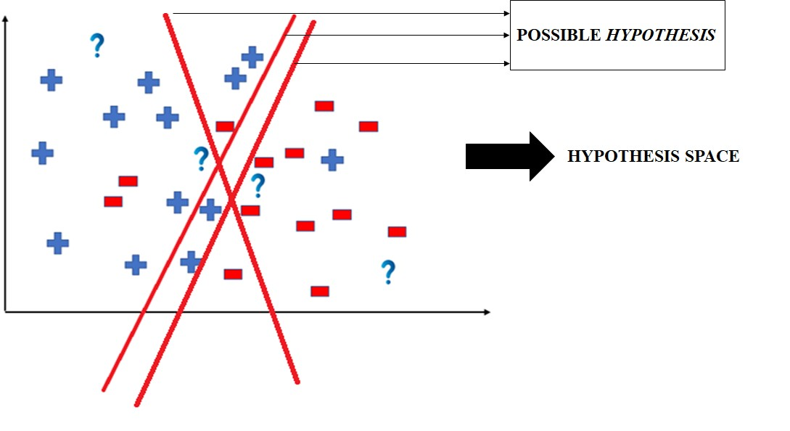
HYPOTHESIS SPACE
Fig. Predicts the outcomes by dividing the coordinate
Fig. Predicts the outcomes by dividing the coordinate
Fig. The test data would yield this result
Fig. Example of Hypothesis Space

Slide 42
INDUCTIVE BIAS
Inductive bias is the set of assumptions a machine learning model makes to predict outputs for unseen inputs based on its training data. It provides the model with a "preference" toward certain solutions, which helps it generalize effectively from limited data.
Purpose:
Generalization: Inductive bias enables a model to go beyond the training data, predicting patterns it hasn't explicitly seen.
Guiding Hypothesis Selection: By narrowing down the hypothesis space, inductive bias helps the model focus on likely solutions rather than exploring every possible one.
Types of Inductive Bias:
Language Bias
Search Bias

Slide 43
INDUCTIVE BIAS
• Inductive bias is a key component of any machine learning model. It guides the model's learning process and influences its ability to make predictions on new data.
• The inductive bias is what allows a model to choose one hypothesis over another when multiple hypotheses are consistent with the observed training data.
• Without any inductive bias, a learning algorithm would not be able to generalize beyond the specific training examples it has seen, making it incapable of predicting outcomes for new instances.
• Different learning algorithms have different inductive biases, which affect their performance and suitability for various types of problems. Some common examples of inductive biases include:
1. Occam’s razor: The preference for simpler hypotheses over more complex ones when both are consistent with the observed data. This bias is based on the principle that simpler models are more likely to generalize well to new data.

Slide 44
INDUCTIVE BIAS
2. Smoothness: The assumption that nearby points in the input space are likely to have similar outputs. This bias is often used in regression and classification problems and is the basis for kernel methods and radial basis function networks.
3. Feature selection: The assumption that only a subset of input features is relevant to the target variable. This bias is used in many feature selection algorithms, which aim to identify and use the most informative features for learning.
4. Hierarchical structure: The assumption that the underlying structure of the data can be represented by a hierarchy of concepts or features. This bias is in deep learning models, which learn hierarchical representations of the data through multiple layers of abstraction.
• Inductive bias is a crucial aspect of machine learning, as it influences a model’s ability to generalize to new data. Selecting an appropriate inductive bias for a specific problem is an essential step in the design of effective machine learning algorithms.

Slide 45
GENERALIZATION
Generalization defines the ability of an ML model to provide a suitable output by adapting the given set of unknown input. It means after providing training on the dataset, it can produce reliable and accurate output.
General Terms:
Signal: It refers to the true underlying pattern of the data that helps the machine learning model to learn from the data.
Noise: Noise is unnecessary and irrelevant data that reduces the performance of the model.
Bias: Bias is a prediction error that is introduced in the model due to oversimplifying the machine learning algorithms. Or it is the difference between the predicted values and the actual values.
Variance: If the machine learning model performs well with the training dataset, but does not perform well with the test dataset, then variance occurs.

Slide 46
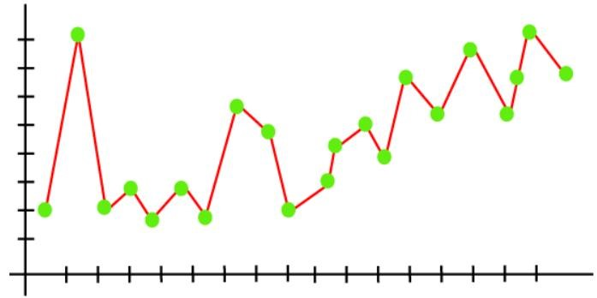
GENERALIZATION
1. Overfitting :
• Overfitting occurs when our machine learning model tries to cover all the data points or more than the required data points present in the given dataset. Because of this, the model starts caching noise and inaccurate values present in the dataset, and all these factors reduce the efficiency and accuracy of the model. The overfitted model has low bias and high variance.
• The chances of occurrence of overfitting increase as much we provide training to our model. It means the more we train our model, the more chances of occurring the overfitted model.
Fig. Overfitting graph of the linear regression
• As we can see from the above graph, the model tries to cover all the data points present in the scatter plot, the goal of the regression model to find the best fit line, but here we have not got any best fit, so, it will generate the prediction errors.

Slide 47
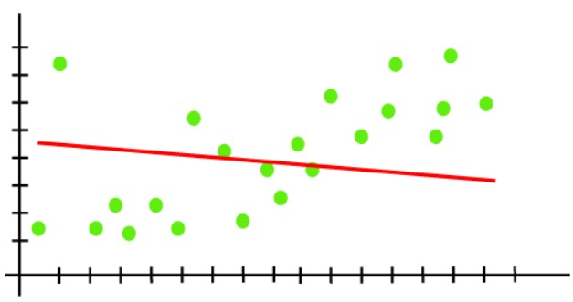
GENERALIZATION
2. Underfitting :
• Underfitting occurs when our machine learning model is not able to capture the underlying trend of the data. To avoid the overfitting in the model, the fed of training data can be stopped at an early stage, due to which the model may not learn enough from the training data.
• In the case of underfitting, the model is not able to learn enough from the training data, and hence it reduces the accuracy and produces unreliable predictions.
Fig. Underfitting in linear regression model
An underfitted model has high bias and low variance.
From the diagram, the model is unable to capture the data points present in the plot.

Slide 48
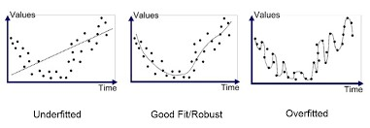
GENERALIZATION
The "Goodness of fit" term is taken from the statistics, and the goal of the machine learning models to achieve the goodness of fit. In statistics modeling, it defines how closely the result or predicted values match the true values of the dataset.
The model with a good fit is between the underfitted and overfitted model, and ideally, it makes predictions with 0 errors, but in practice, it is difficult to achieve it.
The errors in the test dataset start increasing, so the point, just before the raising of errors, is the good point, and we can stop here for achieving a good model.
Resampling method and validation dataset are two other methods for good point of model.

Slide 49
GENERALIZATION
Goodness of Fit :
• The "Goodness of fit" term is taken from the statistics, and the goal of the machine learning models to achieve the goodness of fit. In statistics modeling, it defines how closely the result or predicted values match the true values of the dataset.
• The model with a good fit is between the underfitted and overfitted model, and ideally, it makes predictions with 0 errors, but in practice, it is difficult to achieve it.
• As when we train our model for a time, the errors in the training data go down, and the same happens with test data. But if we train the model for a long duration, then the performance of the model may decrease due to the overfitting, as the model also learn the noise present in the dataset.

Slide 50
BIAS-VARIANCE TRADE-OFF
1. Bias:
Definition: Bias refers to the error done by overly simplistic assumptions made by the model.
Effect: High bias means the model is too simple to capture the underlying patterns in the data, leading to underfitting.
Result: A model with high bias will have poor performance on both training and test data because it cannot represent the complexity of the data.
2. Variance:
Definition: Variance refers to the error introduced by the model’s sensitivity to small fluctuations or noise in the training data.
Effect: High variance means the model is too complex and overfits, learning the noise and details of the training set rather than the underlying pattern.
Result: A model with high variance will perform well on training data but poorly on new, unseen test data because it has "memorized" the training examples.

Slide 51
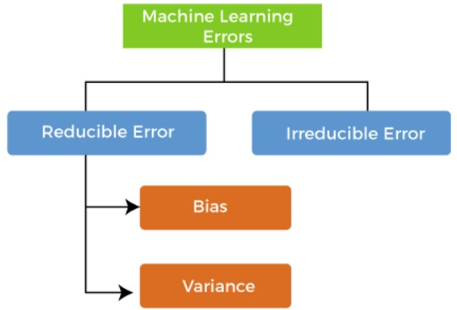
BIAS-VARIANCE TRADE-OFF
Errors in Machine Learning
• In machine learning, an error is a measure of how accurately an algorithm can make predictions for the previously unknown dataset.
• On the basis of these errors, the machine learning model is selected that can perform best on the particular dataset.

Slide 52
BIAS-VARIANCE TRADE-OFF
What is Bias?
• A machine learning model analyses the data, find patterns in it and make predictions. While training, the model learns the patterns in the dataset and applies to test data for prediction.
• While making predictions, a difference occurs between prediction values made by the model and actual values/expected values, and this difference is known as bias errors or Errors.
• Bias can be defined as an inability of machine learning algorithms such as Linear Regression to capture the true relationship between the data points. Each algorithm begins with some amount of bias because bias occurs from assumptions in the model, which makes the target function simple to learn. A model has either:
Low Bias: A low bias model will make fewer assumptions about the form of the target function.
High Bias: A model with a high bias makes more assumptions, and the model becomes unable to capture the important features of our dataset. A high bias model also cannot perform well on new data.

Slide 53
BIAS-VARIANCE TRADE-OFF
What is Bias?
• A machine learning model analyses the data, find patterns in it and make predictions. While training, the model learns the patterns in the dataset and applies to test data for prediction.
• While making predictions, a difference occurs between prediction values made by the model and actual values/expected values, and this difference is known as bias errors or Errors.
• Bias can be defined as an inability of machine learning algorithms such as Linear Regression to capture the true relationship between the data points. Each algorithm begins with some amount of bias because bias occurs from assumptions in the model, which makes the target function simple to learn. A model has either:
Low Bias: A low bias model will make fewer assumptions about the form of the target function.
High Bias: A model with a high bias makes more assumptions, and the model becomes unable to capture the important features of our dataset. A high bias model also cannot perform well on new data.

Slide 54
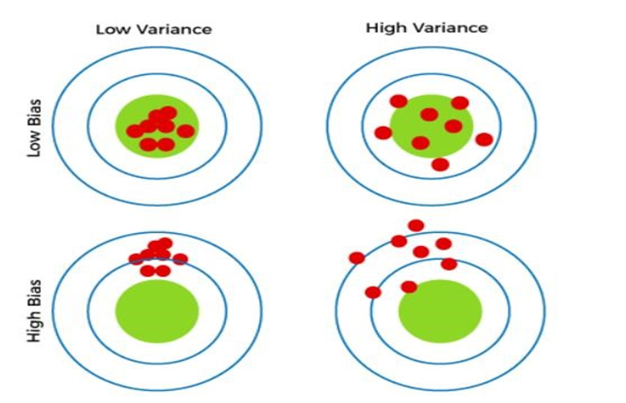
BIAS-VARIANCE TRADE-OFF
What is a Variance Error?
The variance would specify the amount of variation in the prediction if the different training data was used. Variance tells that how much a random variable is different from its expected value. A model should not vary too much from one training dataset to another.
Variance errors are either of low variance or high variance, which means :
Low variance means there is a small variation in the prediction of the target function with changes in the training data set.
High variance shows a large variation in the prediction of the target function with changes in the training dataset.

Slide 55
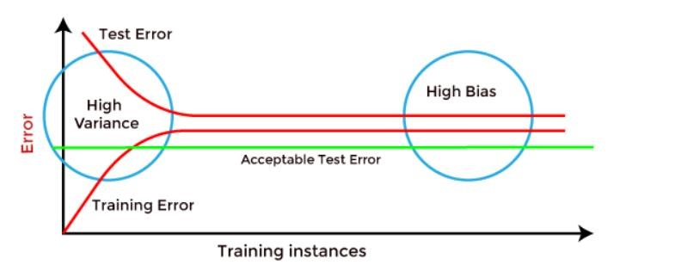
BIAS-VARIANCE TRADE-OFF
1. Low-Bias, Low-Variance: The combination of low bias and low variance shows an ideal machine learning model. However, it is not possible practically.
2. Low-Bias, High-Variance: With low bias and high variance, model predictions are inconsistent and accurate on average. This case occurs when the model learns with a large number of parameters and hence leads to an overfitting
3. High-Bias, Low-Variance: With High bias and low variance, predictions are consistent but inaccurate on average. This case occurs when a model does not learn well with the training dataset or uses few numbers of the parameter. It leads to underfitting problems in the model.
4. High-Bias,High-Variance: With high bias and high variance, predictions are inconsistent &inaccurate on average.

Slide 56
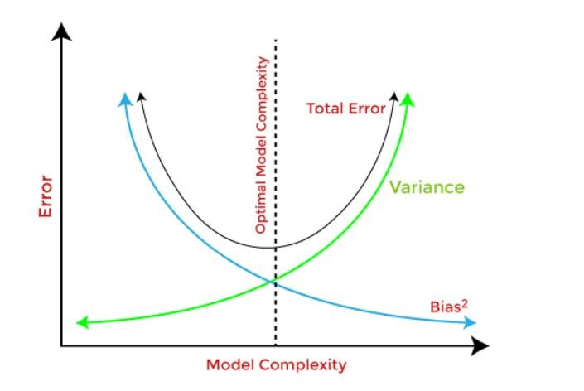
BIAS-VARIANCE TRADE-OFF
Bias-Variance Trade-Off :
While building the machine learning model, it is really important to take care of bias and variance in order to avoid overfitting and underfitting in the model. If the model is very simple with fewer parameters, it may have low variance and high bias. Whereas, if the model has a large number of parameters, it will have high variance and low bias. So, it is required to make a balance between bias and variance errors, and this balance between the bias error and variance error is known as the Bias-Variance trade-off
For an accurate prediction of the model, algorithms need a low variance and low bias. But this is not possible because bias and variance are related to each other:
If we decrease the variance, it will increase the bias.
If we decrease the bias, it will increase the variance.

Slide 57
BIAS-VARIANCE TRADE-OFF VISUALIZATION
THANK YOU..

